Slide 1


ETrack Solutions
By
EDS INDIA (P) LTD

Slide 2
Agenda
Introduction
Working Process
Key Features
Block Diagram
Existing Models
ETrack v/s Honda Connect
Presented By EDS INDIA (P) LTD

Slide 3
Introduction
Technology
Description
The Vehicle tracking system is a total security protection and fleet management solution. By using the latest GSM & GPS technology to protect and monitor vehicles like cars, trucks, buses (moveable asset) virtually anywhere and then locate it to within in a few meters.

Slide 4
Introduction
Description
Technology
To Understand the whole operation of VTS Device, we can divide the whole working into two parts.
Tracking the location of Vehicle via GPS.
Provide the location information via GSM network.

Slide 5
Working Process
VTS Working process can be divided into two methods:
Tracking via GPS
Tracking via GSM
Tracking via GPS
Tracking via GSM

Slide 6
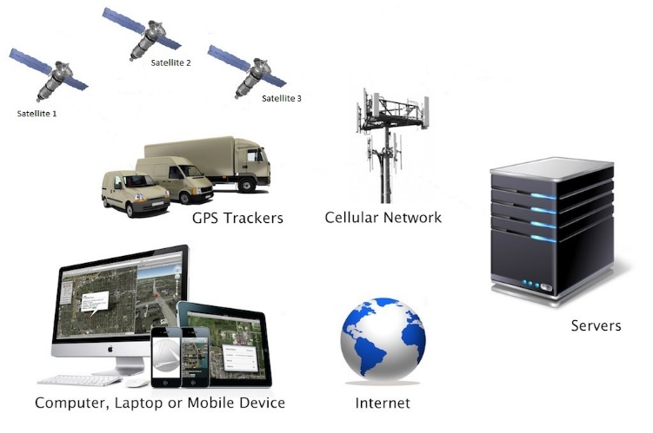
Working Process
GPS Receiver takes information from satellite and use triangulation calculation method to extract the device location. Essentially, the GPS receiver compares the time a signal was transmitted by a satellite with the time it was received to calculate the distance.
Tracking Via GPS
Once the location information is extracted by the GPS receiver the same is uploaded to server using GSM networks in a manner similar to which we get SMS or send SMS to/from our mobile devices.

Slide 7
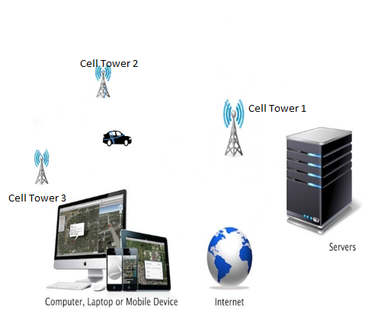
Working Process
GSM triangulation is very useful in dark zone areas where GPS has no accessibility. It provides a tentative location of device. Device determines its location using cell tower triangulation method and send to server via GSM network.
Tracking Via GSM

Slide 8
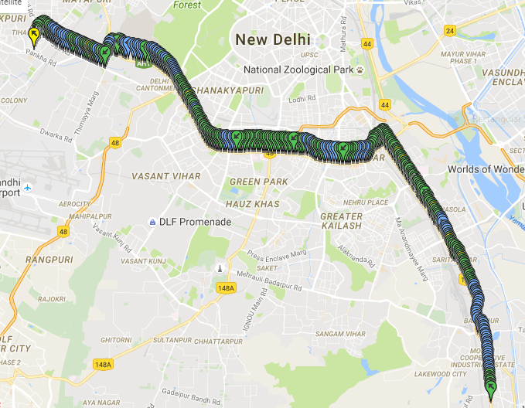
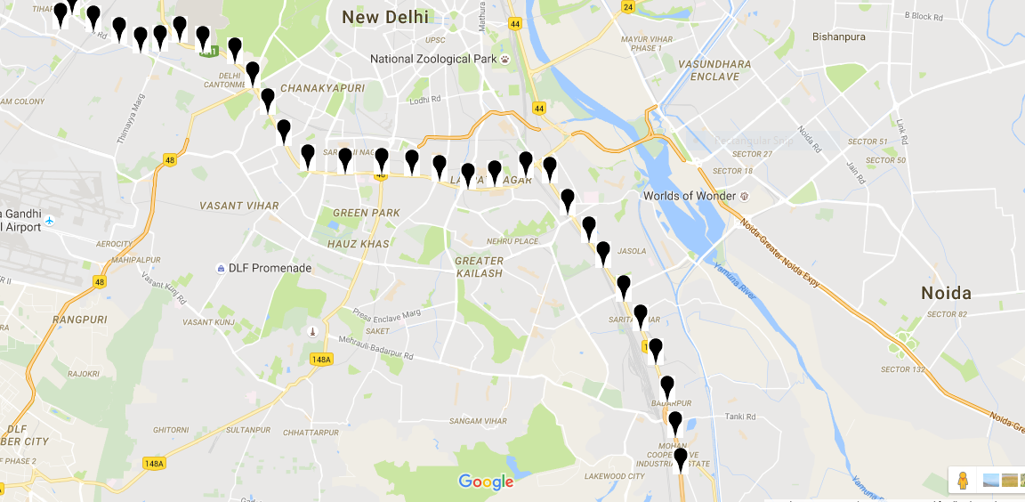
Working Process
TRACKING VIA GPS V/S TRACKING VIA GSM

Slide 9
Key features
GPS Dark zone / multi path elimination using LBS & Cell Tower Triangulation
Internal GSM & GPS/GNSS antenna
Real-Time Process Monitoring
Highly configurable data acquisition
Firmware upgrade over the air(OTA)
Authorized number for remote access
SMS & Email alerts
TCP/IP or UDP/IP protocol supported
Two way Audio(Communication)
Configurable scenarios available including I/O’s via Server & SMS
Configurable Ex. & Int. Battery Cut-off
Auto Power-cut from vehicle battery
Geofence supported
Sleep Mode & Deep Sleep Mode
SMS Tracking (Configurable Interval)
Virtual Trip Meter.
Up to 30K records storing capacity
Reverse Geo Address
Supports Multiple Server.

Slide 10
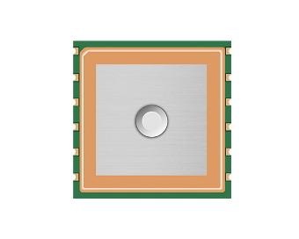
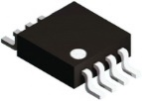
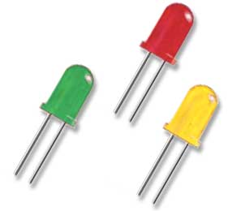
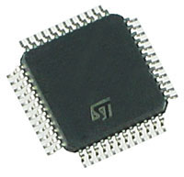
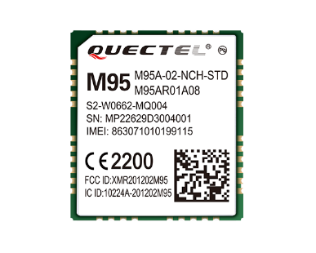

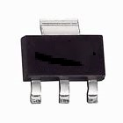
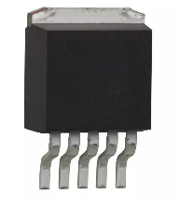

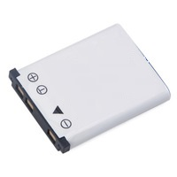
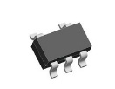
Block diagram
I/O
Flash Memory
GPS
LED Indication
RS 232
GPRS/GSM
MCU
Battery
Regulator 2
SIM
Int. Battery
Regulator 1
Charging IC

Slide 11
EXISTING MODELS
ETrack-312
ETrack-442
ETrack-OBDII

Slide 12
EXISTING MODELS
Features | ETrack-312 | ETrack-442 | ETrack-OBDII
Device USP | Dual Server | Audio & Accelerometer | OBDII Supported
Digital Input | 2+1 | 3+1 | X
Digital Output | 2 | 2 | X
Analog Input | 1 | 4 | X
Audio | X | ✓ | X
Accelerometer | X | ✓ | X
Tampering | SIM/Power/Internal Battery/Box |  | SIM
Indication | Power, Ignition, GPRS, GPS
FW-OTA(Manual/Auto) | ✓ | ✓ | ✓

Slide 13
EXISTING MODELS
Features | ETrack-312 | ETrack-442 | ETrack-OBDII
Configuration via SMS/Server | ✓ | ✓ | ✓
Virtual Trip Meter / Trip Analysis | ✓ | ✓ | ✓
Smart Data Acquisition | Based on Time/Distance/Angle/Events & Ignition
Configurable SMS Alerts | Ignition, Power, Over Speed, Tow, Geofence, SMS Tracking, Rev. Geo
Auto-cut Vehicle Battery | ✓ | ✓ | X
Internal Battery | ✓ | ✓ | X
OBDII Protocol | X | X | ✓

Slide 14
EXISTING MODELS
Features | ETrack-312 | ETrack-442 | ETrack-OBDII
Vehicle Behaviour & Health Monitoring | X | X | ✓
Over Speed, Tow Speed | ✓ | ✓ | ✓

Slide 15
ETrack v/s Honda Connect
(Safety & Security)
Feature | Honda Connect | ETrack
Impact alert
Share My Location
Locate my car
Vehicle health monitoring
Trip analysis
Manual SOS
SMS Feedback
SMS Tracking
✓
✓
✓
✓
✓
✓
x
x
✓
✓
✓
✓
✓
✓
✓
✓

Slide 16
ETrack v/s Honda Connect
(Safety & Security)
Safety & Security | Honda Connect | ETrack
Over Speed , Tow Alert
Tampering Alert
Real Time Monitoring
Authorized number for remote access
Geofence Alert
x
x
x
x
x
✓
✓
✓
✓
✓

Slide 17
ETrack v/s Honda Connect
(Convenience)
Feature | Honda Connect | ETrack
Car Calendar
Service Booking
Service History
Past Car Invoice
Consolidated all Car information
Call Now (Honda Care/Dealer)
What’s New
Pits Stop
✓
✓
✓
✓
✓
✓
✓
✓
✓ (Need OEM Input)
✓
✓ (Need OEM Input)
✓ (Need OEM Input)
✓ (Need OEM Input)
✓
✓ (Need OEM Input)
✓

Slide 18
ETrack v/s Honda Connect
(Convenience)
Feature | Honda Connect | ETrack
User Feedback
Generate A new car enquiry
Fuel Log Book
Tracking Via GSM
Honda Car information
Refer a friend
Document Wallet
FW Upgrade OTA
✓
✓
✓
✓
✓
✓
x
x
✓ (Need OEM Input)
✓
✓
✓
✓ (Need OEM Input)
✓ (Need OEM Input)
✓
✓

Slide 19
ETrack v/s Honda Connect
(Convenience)
Feature | Honda Connect | ETrack
Configurable Parameters
Element event triggers
Multiple Server
Rev. Geo Address to Mobile
x
x
x
x
✓
✓
✓
✓

